Slide 1
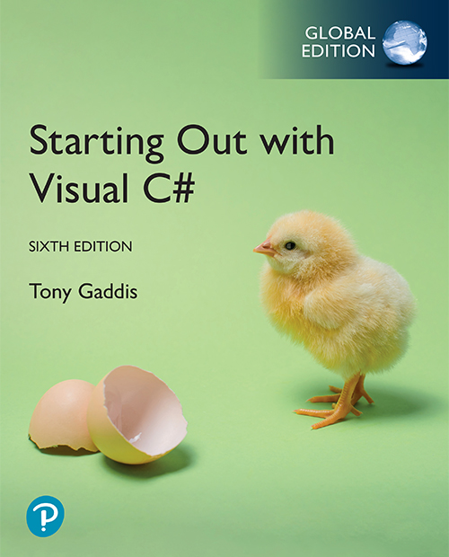
Starting out with Visual
Sixth Edition, Global Edition
Chapter 4
Loops, Files, and Random Numbers
© 2024, Pearson Education, Ltd. All Rights Reserved
Notes:
If this PowerPoint presentation contains mathematical equations, you may need to check that your computer has the following installed:
1) MathType Plugin
2) Math Player (free versions available)
3) NVDA Reader (free versions available)

Slide 2
Topics
5.1 The while Loop
5.2 The ++ and -- Operators
5.3 The for Loop
5.4 The do-while Loop
5.5 Using Files for Data Storage
5.6 The OpenFileDialog and SaveFileDialog Controls
5.7 Random Numbers
5.8 The Load Event

Slide 3
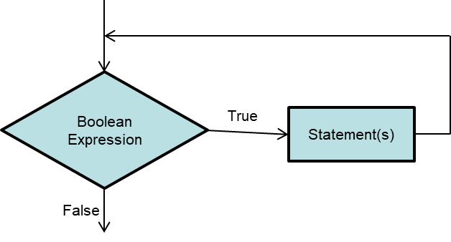
5.1 The while Loop
The while loop causes a statement or set of statements to repeat as long as a Boolean expression is true
The simple logic is: While a Boolean expression is true, do some task
A while loop has two parts:
  A Boolean expression that is tested for a true or false value
  A statement or set of statements that is repeated a long as the Boolean expression is true

Slide 4
Structure of a while Loop
The general format of a while loop is:
while (BooleanExpression)
{
statements
}
The first line is called the while clause
Statements inside the curly braces are the body of the loop
When a while loop executes, the Boolean expression is tested. If true, the statements are executed
Each time the loop executes its statement or statements, we say the loop is iterating, or performing an iteration
counter variables — variables used to track how many times a loop runs.

Slide 5
The while Loop is a Pretest Loop
A while loop is a pretest loop, which means it tests its condition before performing an iteration.
This usually means steps must be taken prior to the loop to ensure it executes at least once.
Example:
int count = 0;
while (count < 5)
{
MessageBox.Show("Hello");
count = count + 1;
}
In order for the loop to iterate at least once, count must
be initialized to a value that is less than 5.
This loop will iterate 5 times.

Slide 6
The while Loop is a Pretest Loop
If a while loop's condition is false to start with, the loop will not iterate.
Example:
int count = 5;
while (count < 5)
{
MessageBox.Show("Hello");
count = count + 1;
}
The loop's condition is false to start with, so this loop
will not iterate.

Slide 7
Infinite Loops
An infinite loop is a loop that will repeats until the program is interrupted
There are few conditions that cause a while loop to be an infinite loop. A typical scenario is that the programmer forgets to write code that makes the test condition false
In the following example, the count variable is never increased. So, the Boolean expression is never false.
int count = 0;
while (count < 5)
{
MessageBox.Show("Hello");
}

Slide 8
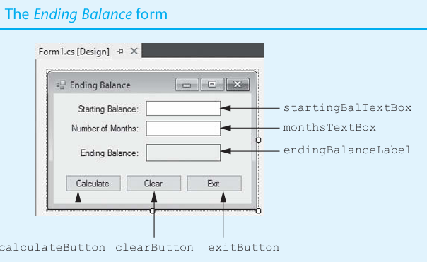


Lap Practice

Slide 9
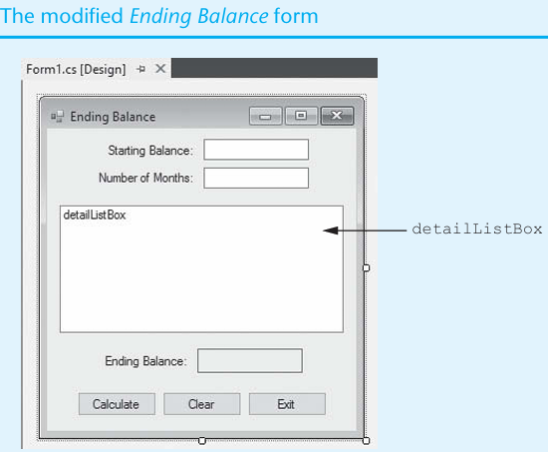
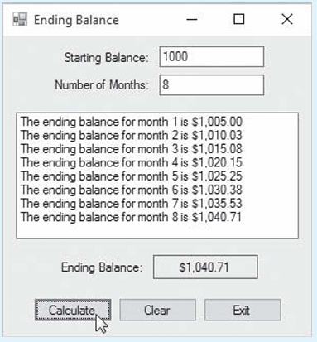
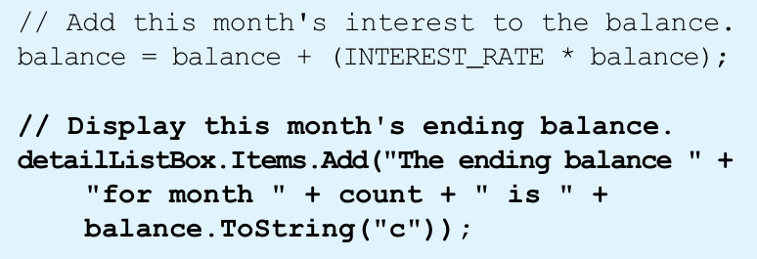
Lap Practice

Slide 10
5.3 The increment and decrement Operators
To increment a variable means to increase its value and to decrement a variable means to decrease its value
C# provides the ++ and -- operators to increment and decrement variables
Adding 1 to a variable can be written as:
count++;
Or
count += 1;
Or
count = count + 1;
Subtracting 1 from a variable can be written as:
count--;
Or
count -= 1;
Or
count = count - 1;

Slide 11
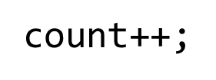
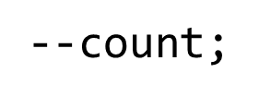
Postfix Mode versus Prefix Mode
Postfix mode means to place the
operators after their operands
Prefix mode means to place the
operators before their operands
Postfix: use old value, then change it.
Prefix: change value first, then use it

Slide 12
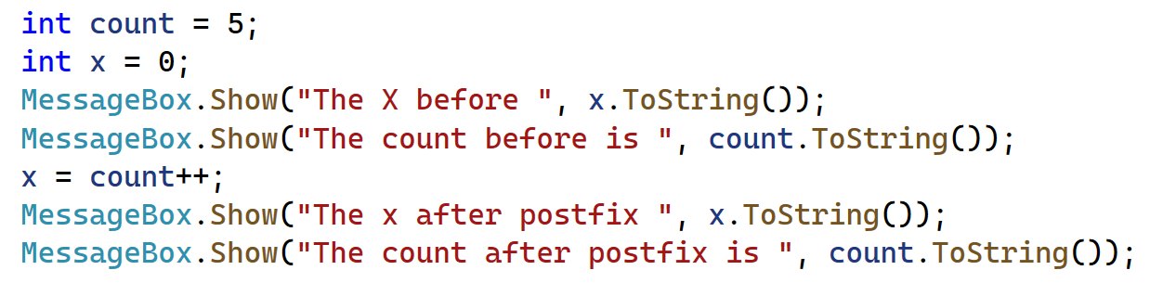
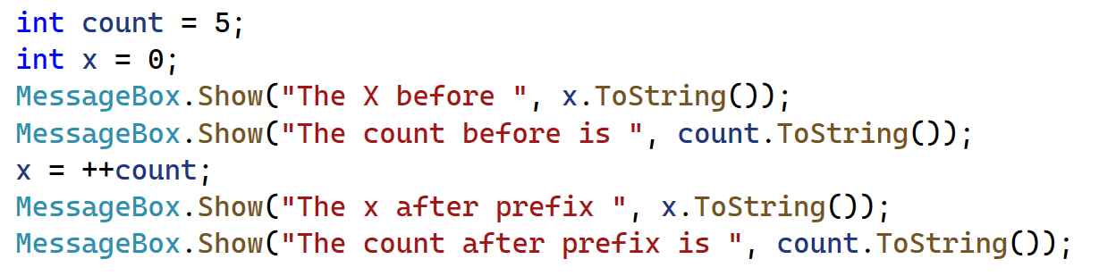
Example of postfix and prefix mode

Slide 13
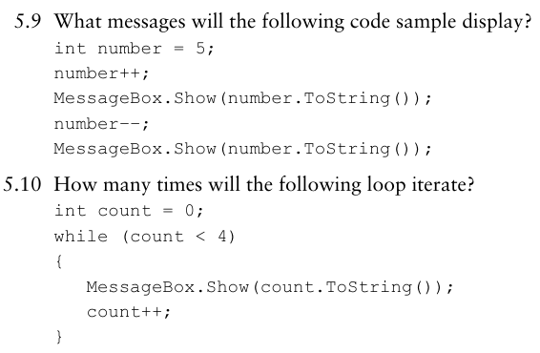
Test Inside Class
Notes:
What messages will the following code sample display?
First Results is = 6
Second results of x =5
How many times will the following loop iterate?
The results of count variable is : 0 ,1 ,2 3

Slide 14
5.4 The for Loop
The for loop is specially designed for situations requiring a counter variable to control the number of times that a loop iterates
You must specify three actions:
  Initialization: a one-time expression that defines the initial value of the counter
  Test: A Boolean expression to be tested. If true, the loop iterates.
  Update: increase or decrease the value of the counter
The general format is:
for (InitializationExpression; TestExpression; UpdateExpression)
{
}
The for loop is a pretest loop

Slide 15
Sample Code (2 of 4)
int count;
for (count = 0; count < 5; count++)
{
MessageBox.Show("Hello");
}
// Declare the count variable in the
// initialization expression.
for (int count = 0; count < 5; count++)
{
MessageBox.Show("Hello");
}
The initialization expression assigns 1 to the count variable.
The expression count < 5 is tested. If true, the loop iterates.
The update expression adds 1 to the count variable.
The loop starts over.

Slide 16
Other Forms of Update Expression
In the update expression, the counter variable is typically incremented by 1. But this is not a requirement.
// Increment by 10.
for (int count = 0; count <= 100; count += 10)
{
MessageBox.Show(count.ToString());
}
You can decrement the counter variable to make it count backward
// Counting backward.
for (int count = 10; count >= 0; count--)
{
MessageBox.Show(count.ToString());
}

Slide 17
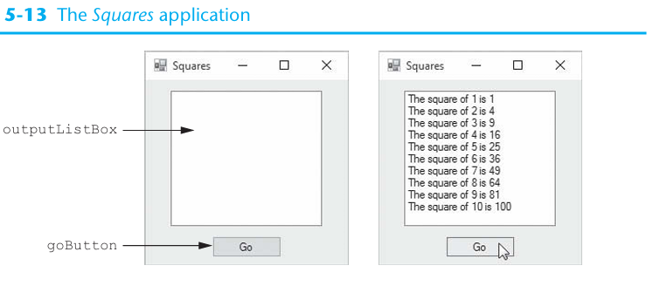
Lab practice

Slide 18
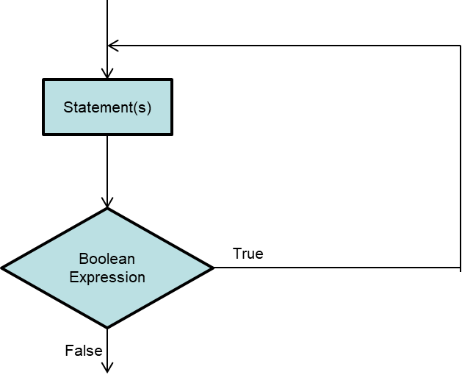
5.5 The do-while Loop
The do-while loop is a posttest loop, which means it performs an iteration before testing its Boolean expression.
In the flowchart, one or more statements are executed before a Boolean expression is tested
A generic format is:
do
{
statements…
} while (BooleanExpression);

Slide 19
Sample Code
Will you see the message box?
int number = 1;
do
{
MessageBox.Show(number.ToString());
} while (number < 0);
Will you see the message box?
int number = 1;
while (number < 0)
{
MessageBox.Show(number.ToString());
}

Slide 20
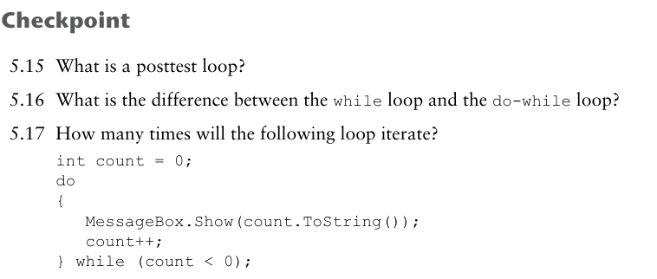
Test In Class

Slide 21
5.6 Using Files for Data Storage
When a program needs to save data for later use, it writes the data in a file
There are always three steps:
  Open the file: create a connection between the file and the program
  Process the file: either write to or read from the file
  Close the file: disconnect the file and the program
In general, there are two types of files:
  Text file: contains data that has been encoded as test using a scheme such as Unicode
  Binary file: contains data that has not been converted to text. You cannot view the contents of binary files with a text editor.
This chapter only works with text files

Slide 22
File Accessing
A file object is an object that is associated with a specific file and provides a way for the program to work with that file
.N E T provides two classes to work with file objects:
  StreamWriter: for writing data to a text file
  StreamReader: for reading data from a text file

Slide 23
Writing Data to a File
Start with creating a StreamWriter object
StreamWriter outputFile;
Use one of the File methods to open the file to which you will be writing data. Sample File methods are:
File.CreateText
File.AppendText
Use the Write or WriteLine method to write items of data to the file
Close the connection.

Slide 24
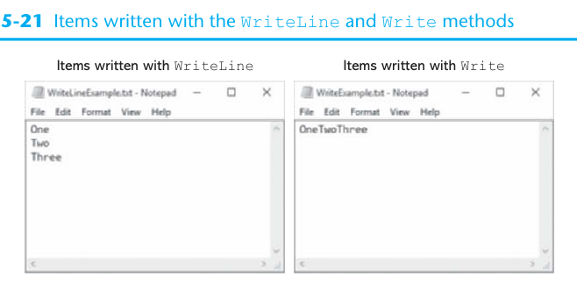
Sample Code (4 of 4)
StreamWriter outputFile;
outputFile = File.CreateText("courses.txt");
outputFile.WriteLine("Introduction to Computer Science");
outputFile.WriteLine("English Composition");
outputFile.WriteLine("Calculus I");
outputFile.Close();
The WriteLine method writes an item of data to a file and then writes a newline characters which specifies the end of a line
The Write method writes an item to a file without a newline character

Slide 25
CreateText versus AppendText
The previous code uses the File.CreateText method for the following reasons:
  It creates a text file with the name specified by the argument. If the file already exists, its contents are erased
  It creates a StreamWriter object in memory, associated with the file
  It returns a reference to the StreamWriter object
When there is a need not to erase the contents of an existing file, use the AppendText method
StreamWriter outputFile;
outputFile = File.AppendText("Names.txt");
outputFile.WriteLine("Lynn");
outputFile.WriteLine("Jamal");
outputFile.WriteLine("Alex");
outputFile.Close();

Slide 26
Specifying the Location of an Output File
If you want to open a file in a different location, you can specify a path as well as filename in the argument
Be sure to prefix the string with the @ character
StreamWriter outputFile = File.AppendText(@"C:\Data\Names.txt");
outbufile = File.CreateText("D:\\C#\\Last_Update_C#\\CA232\\EndBalanceCalc\\bin\\Debug\\listocurse1.doc");

Slide 27
Reading Data from a File
Start with creating a StreamReader object
StreamReader inputFile;
Use the File.OpenText method to open the file to which you will be writing data
inputFile = File.OpenText("students.txt");
Use the Read or ReadLine method to write items of data to the file
  StreamReader.ReadLine: Reads a line of characters from the current stream and returns the data as a string.
  StreamReader.Read: Reads the next character or next set of characters from the input stream.
  StreamReader.ReadToEnd :
  File.ReadAllText :
  Close the connection

Slide 28
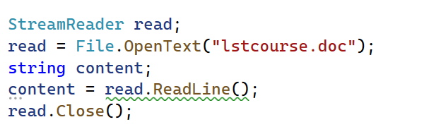
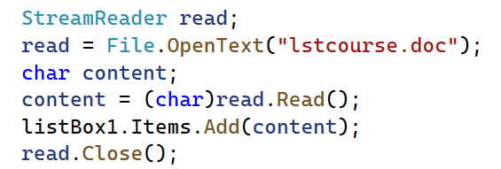
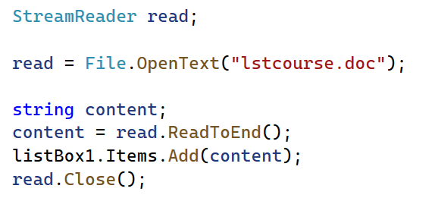
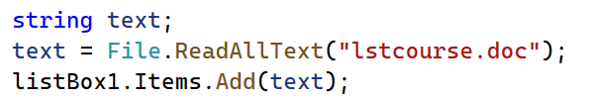
Example of read file

Slide 29
Reading a File with a Loop
StreamReader objects have a Boolean property named EndOfStream that signals whether or not the end of file has been reached
You can write a loop to detect the end of the file.
while (inputFile.EndOfStream == false)
{
}
Or
while (!inputFile.EndOfStream)
{
}

Slide 30
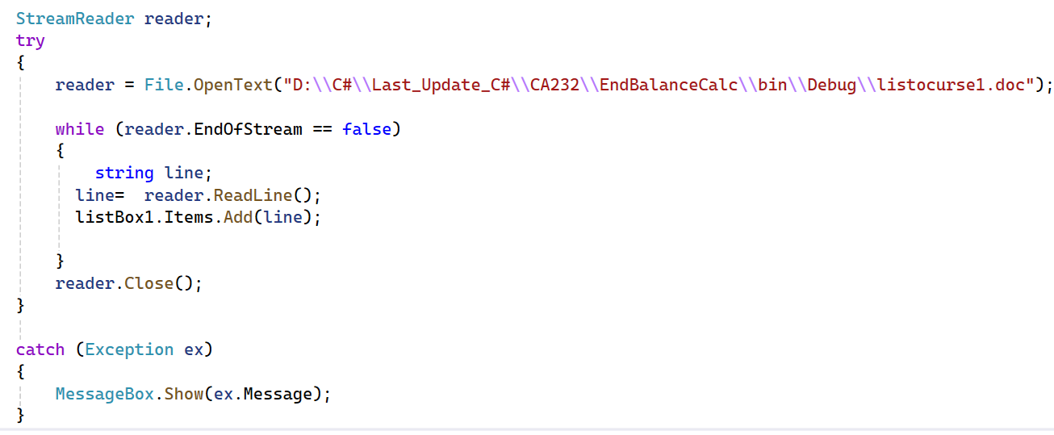
Example of read-line method

Slide 31
5.7 The OpenFileDialog and SaveFileDialog Controls
The OpenFileDialog and SaveDialog controls allow your application to display standard Windows dialog boxes for opening and saving files
Unlike Label, Button, and TextBox, they are invisible controls
The OpenFileDialog control displays a standard Windows Open dialog box.
The SaveDialog control displays a standard Windows Save As dialog box

Slide 32
Displaying an Open Box
When adding an OpenFileDialog control to the form, it does not appear on the form but in an area at the bottom of the Designer called the component tray
In code, you can display an Open dialog box by calling the ShowDialog method:
private void openButton_Click(object sender, EventArgs e)
{
openFileDialog.ShowDialog();
}

Slide 33
Detecting the User’s Selection
The showDialog method returns a DialogResult value that indicates which button the user clicks to dismiss the dialog box
  If the user clicked the Open button, the value DialogResult.OK is returned
  If the user clicked the Cancel button, the value DialogResult.Cancel is returned
  The following is an example that calls the ShowDialog method to determine the user’s choice:
DialogResult result = openFileDialog.ShowDialog();
if (result == DialogResult.OK)
{
}
else if (result == DialogResult.Cancel)
{
}

Slide 34
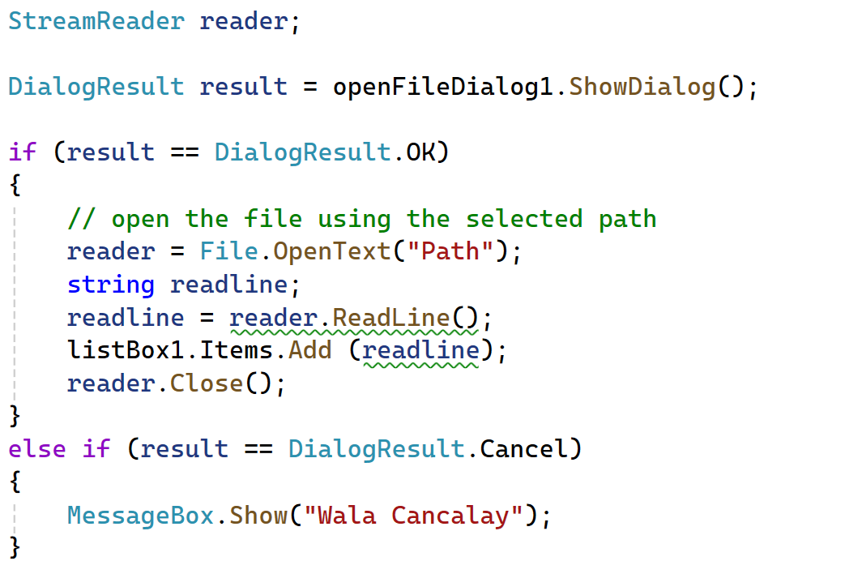
Example of Dialog results ok or cancel

Slide 35
The Filename and InitialDirectory Property
When the user selects a file with the Open dialog box, the file’s path and filename are stored in the control’s Filename property
The following is an example of how to open the selected file:
if (openFileDialog.ShowDialog() == DialogResult.OK)
{
inputFile = File.OpenText(openFileDialog.Filename);
}
You can specify a directory to be initially displayed with the InitialDirectory property. For example,
openFileDialog.InitialDirectory = @"C:\Data";

Slide 36
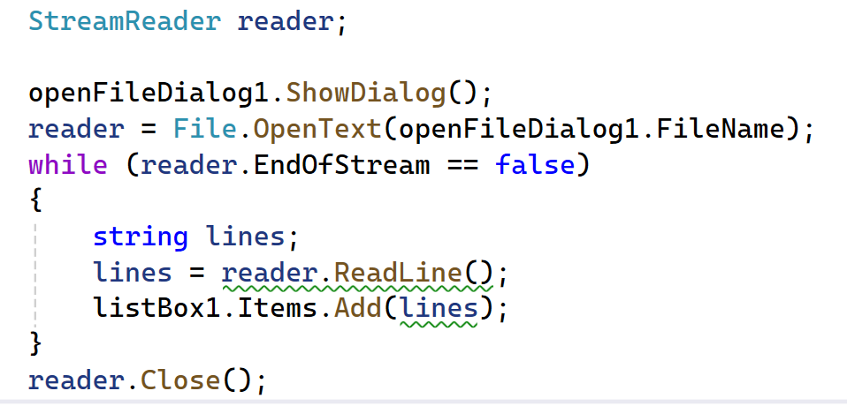
Examples of filename

Slide 37
Displaying a Save As Dialog Box
Use the following to call the SaveFileDialog control’s ShowDialog method
saveFileDialog.ShowDialog()
Use the following to detect the user’s choice
if (saveFileDialog.ShowDialog() == DialogResult.OK)
{
}
Use the following to open the selected file
if (saveFileDialog.ShowDialog() == DialogResult.OK)
{
outputFile = File.CreateText(openFile.Filename);
}

Slide 38
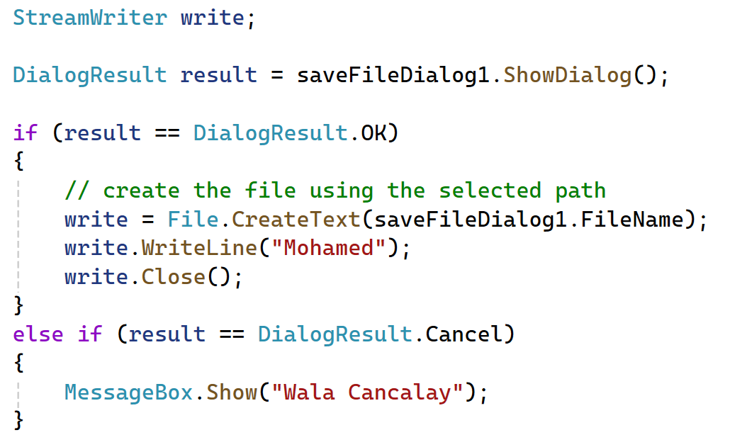
Save Diaglog

Slide 39
5.8 Random Numbers
.N E T provides the Random class to generate random numbers.
To create an object, use:
Random rand = new Random();
Two commonly used methods to generate random numbers are:
  Next: randomly create an integer
  NextDouble: randomly create a floating-point number from 0.0 to 1.0
Examples,
int number1 = rand.Next();
double number2 = rand.NextDouble();

Slide 40
Syntax of the Random.Next Method
Random.Next generates a random number whose value ranges from 0 to 2,147,483,647
It also allows you to generate a random number whose value ranges from zero to some other positive number. The syntax is:
RandomObject.Next(max + 1)
For example, to create a random number from 0 to 99, use:
int number = rand.Next(100);

Slide 41
5.9 The Load Event
When running an application, the application’s form is loaded into memory and an event known as Load takes place
To create a Load event handler, simply double click the form in the Designer
An empty Load event handler looks like:
private void Form1_Load(object sender, EventArgs e)
{
}

Slide 42
5.9 The Load Event
Any code you write inside the Load event will execute when the form is launched. For example,
private void Form1_Load(object sender, EventArgs e)
{
MessageBox.Show("Prepare to see the form!");
}

Slide 43
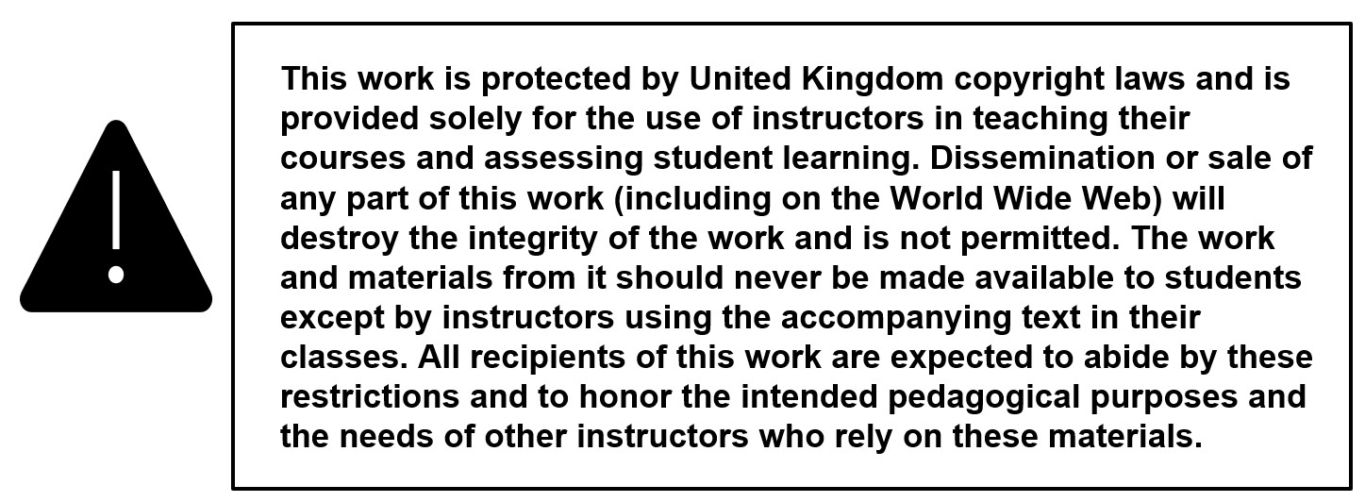
Copyright

